Slide 1
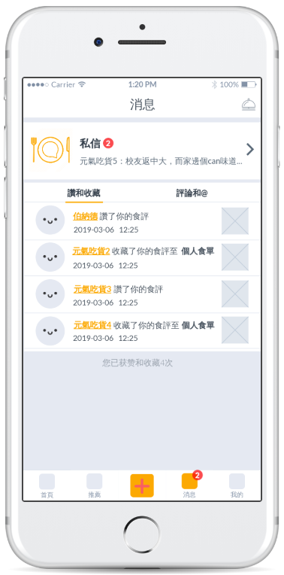
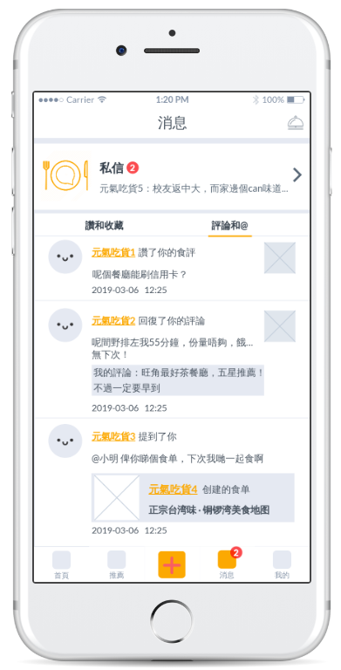
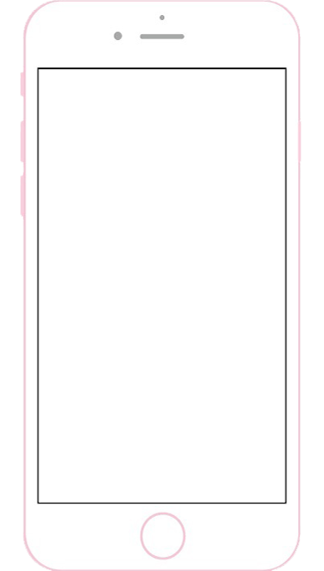
4. Message Page
Like and Store
Comment and Mention
Mute button | Turn off all message sounds and reminders
Chat | Enter the Chat page
Comment and mention | Check who comments on your food reviews and who mention you
Like and store | Check who likes and store your food reviews
User avatar and name | Click to see the user's profile
Image | The image of your posts

Slide 2
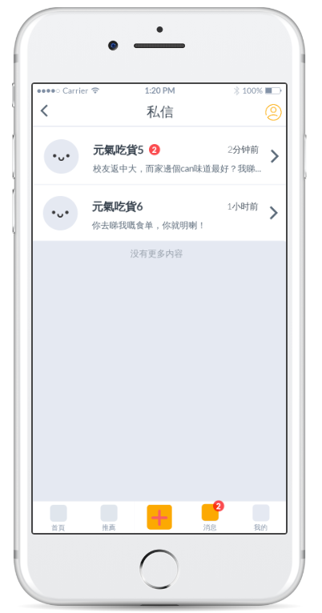
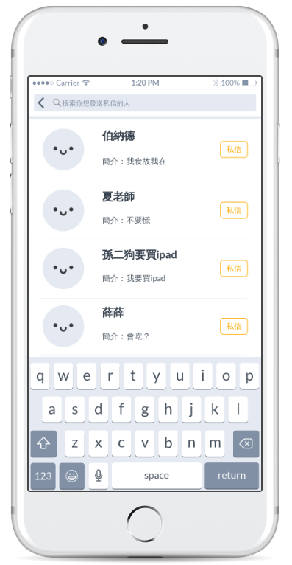
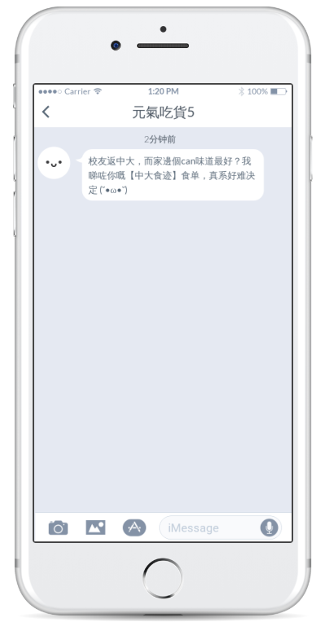
Chat Page
4. Message Page
Contacts
Start Chatting

